Slide 1


Proposal Defence FYP I
Easy Parcel: IoT-Based Parcel Storage System for University Villages
Presented by:
Muhammad Afiq bin Zakaria
21001351
Bachelor of Computer Science (Hons)
Presented to:
Dr Siti Nurlaili Bt Karim
Ts Dr M Luqman B Mahamad Zakaria
04.07.2025 (Friday)
Notes:
Assalamualaikum and good evening to the panel Dr Nurlaili and Dr Luqman. My name is Muhammad Afiq bin Zakaria, and I will be presenting my Final Year Project proposal, titled 'Easy Parcel: IoT-Based Parcel Storage System for University Villages

Slide 2

AGENDA
03
Introduction
10
Literature Review
14
Methodology
21
Conclusion & Future Works
Notes:
This is the agenda of my presentation. I will start with an introduction, which include the background of study, problem statement, project objectives, and scope of study. Then, I will share the literature review, methodology, and finally, conclude with future work.

Slide 3

INTRODUCTION

Slide 4

INTRODUCTION
UNIVERSITI TEKNOLOGI PETRONAS (UTP)
Final Year Project I
OBJECTIVES
The purpose of the project is to develop a framework, which will enhance students' skills in the process of applying knowledge, expanding thoughts, solving problems independently and presenting findings through minimum guidance and supervision.
Notes:
The Final Year Project allows students to apply what they’ve learned in real-world problem solving. It helps us develop critical thinking, technical writing, and project planning skills. We are expected to work independently with minimal supervision while preparing to deliver our final outcome confidently.

Slide 5



INTRODUCTION
WHAT?
IMPORTANCE
Network of interconnected devices that collect, send, and receive data through the internet to automate and improve processes.
Enables automation and real-time monitoring
Increases efficiency and reduces manual work
Internet of Things (IoT)
APPLICATION
FEATURES
Smart Homes
Healthcare
Transportation
Agriculture
Logistics and Delivery
TECHNOLOGIES USED
Remote access & control
Data collection & analytics
Integration with mobile apps
Sensors & Actuators
Microcontrollers (e.g., ESP32, Raspberry Pi)
Cloud Platforms & Mobile Apps
Notes:
What is IoT?
This project makes use of the Internet of Things, which we called IoT, it is a system where devices are connected and able to communicate over the internet. These devices include sensors, microcontrollers, and actuators that can collect, send, and receive data. IoT is a core technology in many modern applications today, such as smart homes, wearable devices, healthcare systems, agriculture, and industrial automation.
IoT is important because it enables automation and smarter decision-making across many sectors, such as smart homes, agriculture, healthcare, industry, and logistics. With IoT, systems become more efficient, reliable, and responsive. It helps reduce manual work, improve accuracy, and often leads to better use of resources and energy.
Key features of IoT include real-time communication, remote access, data collection and analytics, automation, and the ability to integrate with cloud services. These capabilities make IoT a powerful tool in solving everyday problems and creating smarter systems.

Slide 6

BACKGROUND OF STUDY
1
Malaysia E-commerce Growth
2
University Students Role in E-commerce
E-commerce in Malaysia has seen remarkable growth in recent years
Malaysia is now one of Southeast Asia’s leading digital markets
E-commerce users projected to increase by over 75% reaching expected 18.81 million users by 2029
University students make up a large and growing portion of online shoppers
Known for high digital literacy and frequent internet and mobile usage
Prefer e-commerce for its convenience, affordability, and variety
SUMMARY
ParcelHub was introduced to manage the increasing volume of parcels received by university students.
The system supports the growing trend of online shopping among students.
ParcelHub ensures students receive their parcels safely and at a time that suits their schedule.
It aims to streamline the delivery process and reduce issues like lost or mishandled parcels.
Notes:
Online shopping has become a daily routine among university students, who often order food, clothing, electronics, and academic tools online. With this trend increasing, especially after the COVID-19 pandemic, universities are receiving hundreds of parcels each day. This demand creates the need for an efficient, secure, and accessible delivery system on campus.
Students prefer online shopping due to lower prices, convenience, and the ability to compare products easily. According to statistics, Malaysia’s e-commerce users are projected to exceed 18 million by 2029, indicating that parcel volume will continue to rise. This growing reliance on delivery services makes it crucial for universities to adopt modern solutions for parcel management.
To handle the high volume of deliveries, our university implemented ParcelHub—a centralized location for students to collect their parcels. ParcelHub ensures that parcels are stored in a secure environment and only released to verified students. It helps avoid parcel loss and misplacement.

Slide 7

PROBLEM STATEMENT
While the ParcelHub aims to simplify parcel collection, it still has notable flaws that impact student convenience.
One centralized location (ParcelHub), far from most student residences
Long queues during peak hours
Inconvenient for students without transport
Students must pay additional charges to collect parcels
Creates parking problems for those who drive
Notes:
Even though ParcelHub simplifies parcel handling, there are still several issues. First, there is only one centralized location, which is far from most student hostels. This causes long queues during peak hours. It’s also inconvenient for students without transport, and limited parking creates additional problems. Lastly, students must pay extra fees to collect their parcels, even after paying shipping fees

Slide 8



OBJECTIVES
To implement a random password lock system and barcode scanning for secure identification of parcel senders (couriers) and receivers (students).
To design and develop an IoT-based smart locker system for student villages to store small parcels securely
To build a mobile application for both students and couriers to manage locker access, track deliveries, and receive parcel notifications.
Notes:
This project has three main objectives:

Slide 9
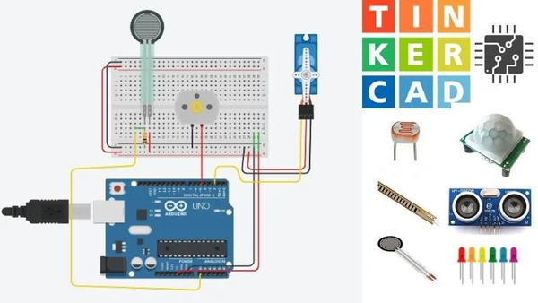


SCOPE OF STUDY
Design and develop a smart locker prototype using microcontrollers, sensors, and electronic locks.
Tinkercad will be used to simulate the circuit design before building the hardware.
Develop a mobile app using Flutter for students and couriers to access lockers, track parcels, and receive notifications.
Data will be managed using Firebase Firestore.
Implement OTP-based access using Firebase Authentication.
Integrate barcode scanning to log parcel sender and receiver details, with records stored in the cloud.
Notes:
The scope of this project is divided into three main areas based on the objectives: hardware development, mobile application development, and integration of authentication and identification features.
For the hardware, I will use the Arduino Uno R3 as the microcontroller. Before building the actual locker system physically, I will simulate the circuit using Tinkercad to test its design and functionality. This helps reduce the risk of hardware errors and allows me to plan the connections for components like servo motors, keypads, and sensors more effectively.
Next, for the mobile application, I will use Flutter to develop a user-friendly interface that works on both Android and iOS. The app will have two different user roles: students and couriers. It will connect to Firebase Firestore to allow real-time data access and syncing between the app and the smart locker system.
Lastly, I will Implement OTP-based access using Firebase Authentication.I also will Integrate barcode scanning to log parcel sender and receiver details, with records stored in the cloud.

Slide 10
LITERATURE REVIEW

Slide 11
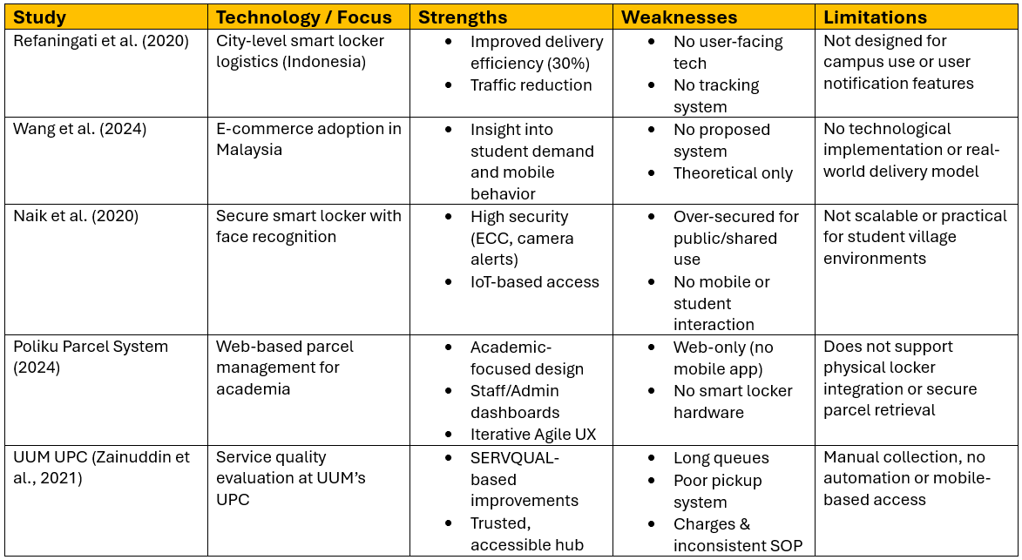


LITERATURE REVIEW
LITERATURE REVIEW - RESEARCH STUDY
Notes:
In this section, I will present findings from related research and existing solutions. I reviewed several academic papers and projects to understand how smart locker systems and parcel handling solutions are currently being developed.
I will focus on three key aspects for comparison:
-The technologies used
-The purpose or target users of the system
-The features offered, including security mechanisms, user interface, and cost-efficiency.
By analyzing these aspects, I aim to highlight the gaps in previous work and show how my project is designed to meet the specific needs of university students living in residential villages.

Slide 12
LITERATURE REVIEW
RESEARCH GAPS
1
Lack of integrated mobile control
2
3
Student-specific design
Access & security balance
Systems like Poliku and UPC use web-based tools but don’t integrate with mobile apps or IoT hardware.
Most systems fail to balance security with usability, making them either too complex for shared campus environments or too basic to ensure parcel safety.
Most systems aren't tailored for students in residential campus settings with limited mobility.
Courier-side support
4
Affordability & Scalability
5
Existing solutions rarely include features that support courier-side access, such as barcode scanning or OTP verification for secure parcel drop-offs.
Commercial systems may be costly and hard to scale or adapt in smaller campus communities.
Notes:
From the literature reviewed, I have identified several specific gaps that my project intends to address:

Slide 13
LITERATURE REVIEW
Solution of The Research Gaps - Easy Parcel
1
Lack of integrated mobile control
2
3
Student-specific design
Access & security balance
Easy Parcel is designed specifically for student residential villages, where students often lack personal transport and need accessible, on-campus parcel services
The system includes a dedicated mobile app, allowing students to receive real-time notifications, track parcels, and open lockers using OTPs
Instead of complex biometric systems, Easy Parcel uses practical OTP, offering secure access without overcomplicating the user experience
Courier-side support
4
Affordability & Scalability
5
Couriers can deliver parcels into specific lockers, reducing delivery errors and enabling secure, contactless drop-offs
The system is prototyped using Arduino for proof of concept, but designed to scale using affordable, off-the-shelf IoT components for real-world deployment in campus
Notes:
Easy Parcel is specifically developed to address the five main gaps that I have identified earlier.

Slide 14
METHODOLOGY

Slide 15
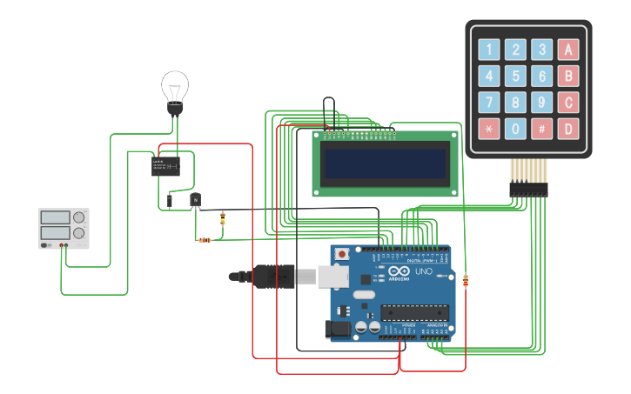
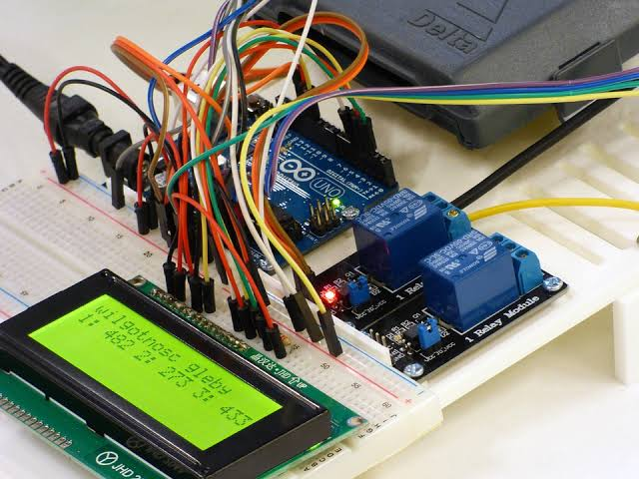
METHODOLOGY
SMART LOCKER - HARDWARE
The Arduino Uno R3 will be used as the main microcontroller to control the smart locker’s hardware components.
Before building the actual prototype, the electronic circuit will be designed and simulated using Tinkercad.
Tinkercad allows for safe, cost-effective testing of component connections, logic flow, and overall system behavior.
1
Once the simulation confirms that the design works as intended, the hardware will be assembled using physical components.
This step-by-step process ensures a smooth transition from design to implementation, minimizing errors and rework.
2
Notes:
The hardware part of this project focuses on designing a working prototype of the smart parcel locker using Arduino Uno R3 as the main controller. I chose Arduino because it is widely used, cost-effective, and easy to program, especially for prototyping small embedded systems.
To begin the development process, I will first design and simulate the circuit in Tinkercad. Tinkercad allows me to visualize and test the connections between components such as servo motors, keypads, LCD displays, and sensors in a virtual environment. This step is crucial to ensure that the components behave as expected before moving on to physical implementation. It also helps reduce hardware damage or wiring errors during testing.
Once the simulation is complete and confirmed to be working, I will proceed to build the physical model. This step-by-step process ensures a smooth transition from design to implementation, minimizing errors and rework.

Slide 16

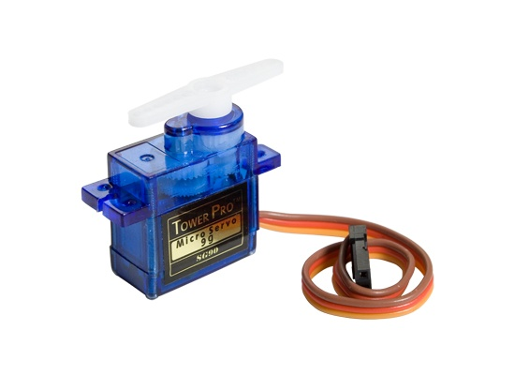
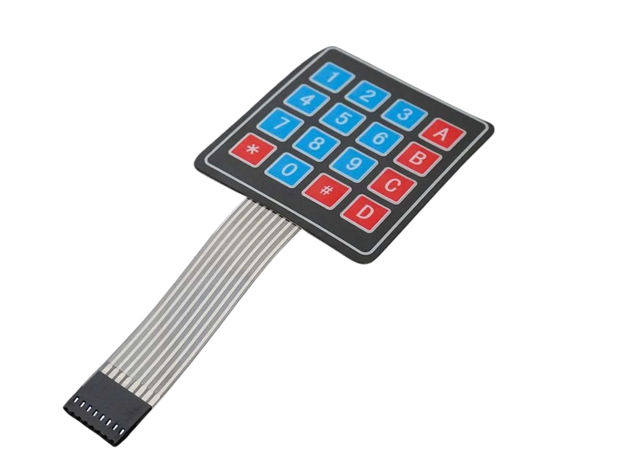
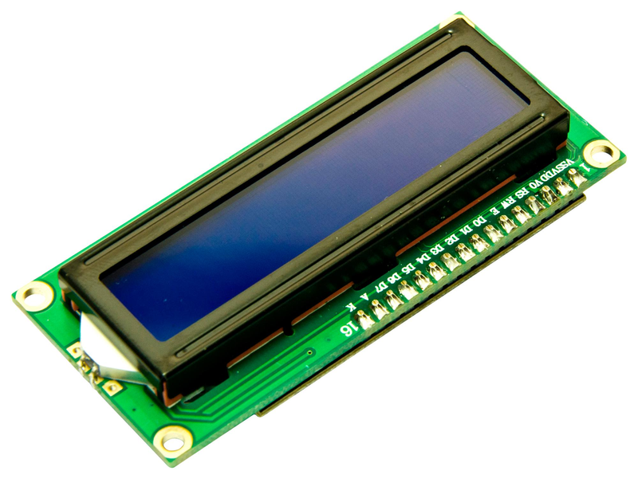
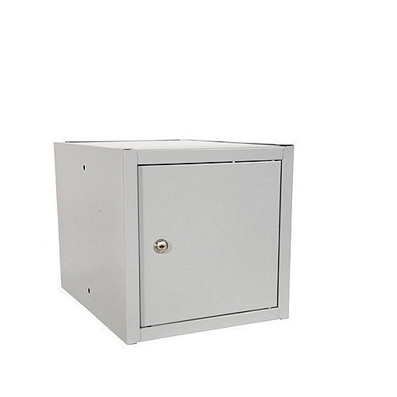
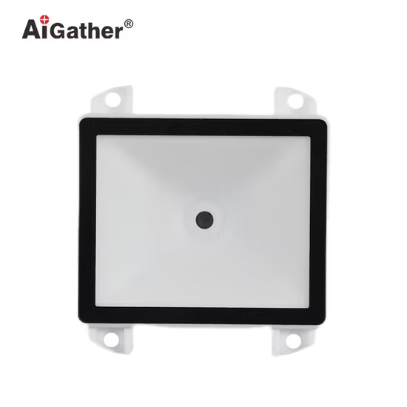
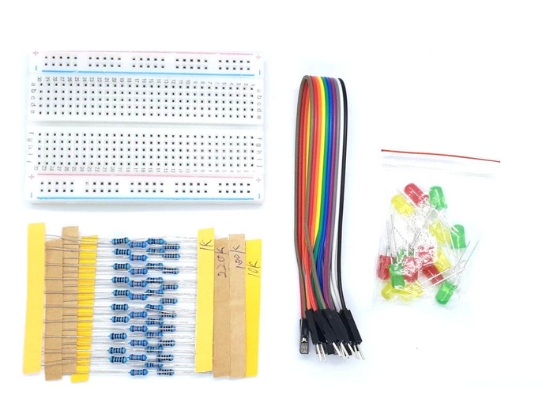
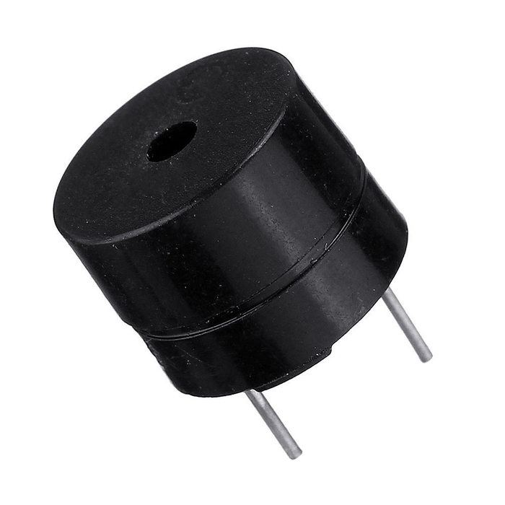
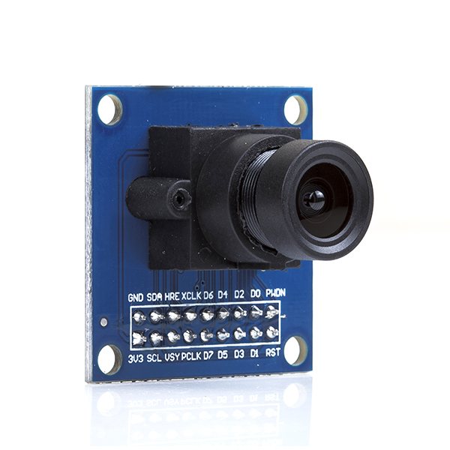
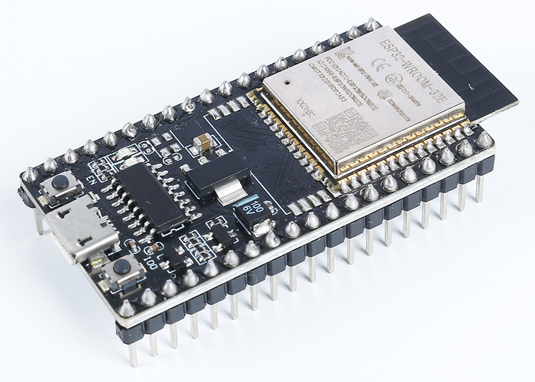
METHODOLOGY
HARDWARE COMPONENTS
1
Arduino Uno R3
2
Servo Motor
3
Keypad
4
LCD
5
Locker
Main microcontroller for controlling inputs and outputs.
To open and close the locker door electronically.
To allow manual entry of OTP or password.
To display status messages or OTP confirmations.
To house the electronics and simulate the parcel storage compartment.
Breadboard, Wires, Capasitor and LED
Barcode Scanner
Buzzer
OV7670
ESP32
6
7
8
9
10
To scan courier and parcel information.
For circuit connections and prototyping.
To provide audible feedback (e.g., when access is granted or denied).
(optional) For capturing images/videos during locker access.
(optional) To enable wireless communication with Firebase if direct integration is needed.
Notes:
These are the main components I plan to use:

Slide 17

METHODOLOGY
MOBILE APPLICATION - SOFTWARE
Development Process
UI Design
App Development
The mobile application will be developed using Flutter, a cross-platform framework by Google that allows building Android and iOS apps from a single codebase. Flutter is chosen for its fast development, beautiful UI capabilities, and seamless integration with Firebase.
Create wireframes and user flow diagrams to outline the structure and navigation of the app.
Build the app using Dart and Flutter’s widget system for smooth, responsive interfaces.
Firebase Integration
Use Firebase Authentication for OTP-based login.
Use Firestore to manage parcel and locker data.
Enable Firebase Cloud Messaging (FCM) for push notifications.
Testing
Perform functional and usability testing to ensure smooth performance across platforms.
Notes:
For the software part I will build the mobile app...
for the development process of the software, first thing I will do is UI design...

Slide 18
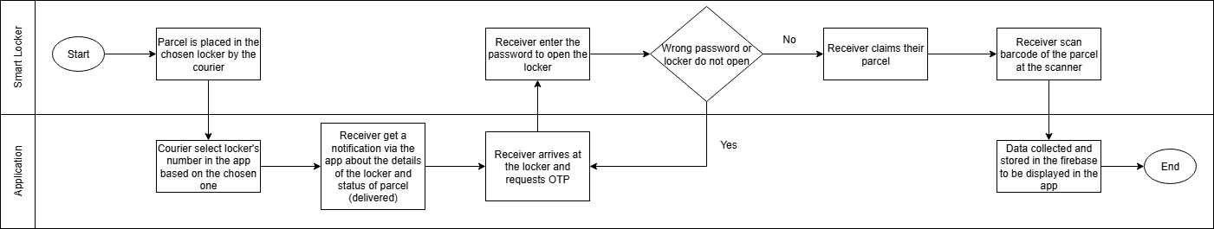
METHODOLOGY
SYSTEM ARCHITECTURE
Notes:
This diagram shows the full system flow. It show the flow of

Slide 19
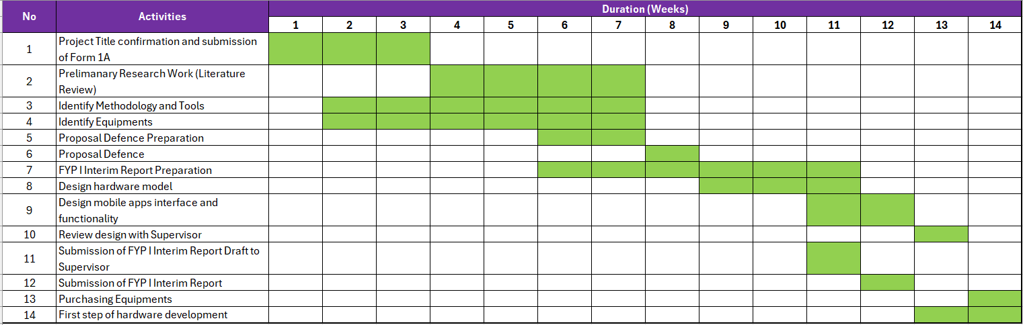
METHODOLOGY
GANNT CHART & MILESTONES - FYP I

Slide 20
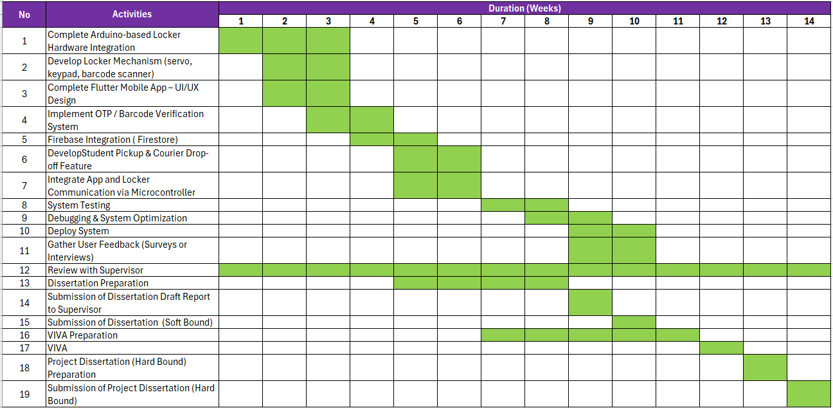
METHODOLOGY
GANNT CHART & MILESTONES - FYP II

Slide 21
CONCLUSION & FUTURE WORKS

Slide 22

CONCLUSION
This project aims to improve the parcel collection experience for students by introducing a smart, secure, and accessible locker system within residential villages. By integrating IoT hardware with a mobile app, it offers a more convenient and efficient solution compared to the current centralized ParcelHub system.

Slide 23

FUTURE WORK
Deeper Understanding of Flutter
Continue exploring advanced Flutter features to improve UI/UX, performance, and maintainability of the mobile app.
1
Enhance System Integration
Improve the integration between the mobile app and hardware components for more stable real-time communication and response.
2
To achieve all outlined objectives and complete the work within the planned timeline
Optimize Firebase Usage
Explore advanced Firebase functions like real-time syncing, cloud functions, and analytics to boost system efficiency.
3
Improve Hardware Troubleshooting Skills
Gain deeper hands-on experience with Arduino components to quickly identify, test, and resolve hardware issues during development.
4

Slide 24
THANK YOU
THANK YOU

